Slide 1

Climate Change Over The Years Using Hadoop
Presented By: Group 5
Tariq Alam, Ismhael Asturias, Julia Budano, Christian Garcia, and Nicholson Kon
CIS 4560-01 (32129)
Introduction to Big Data
Professor Woo
04 May 2026

Slide 2

Agenda
Introduction & Significance
Dataset Overview
Methodology (Hadoop + Processing)
Results & Visualizations
Key Insights
Conclusion

Slide 3

Abstract
Our project utilizes the Climate Change: Earth Surface Temperature Data dataset from Kaggle
The dataset contains monthly global temperature records from the 18th through the 21st century
Our group demonstrates how large-scale climate data can be processed using big data tools, such as Hadoop and Hive
Applies data processing, visualization, and distributed computing to identify long-term warming trends and regional variation

Slide 4

Introduction
Global surface temperatures have increased significantly since the 19th century
Large-scale historical climate datasets require distributed systems for efficient analysis
The dataset includes multi-level geographic data
Our project demonstrates how big data tools can process complex environmental datasets and compare long-term variation across regions

Slide 5
Significance and Research Objectives
Climate change is a critical global issue with widespread environmental, economic, and societal impacts.
Our analysis identifies long-term patterns and regional variations in global temperature change.
Large-scale climate datasets require distributed computing and big data-driven methods for effective analysis.
Our project analyzes historical temperature trends across multiple time periods.
Comparative analysis is conducted across countries, states, and major cities.

Slide 6
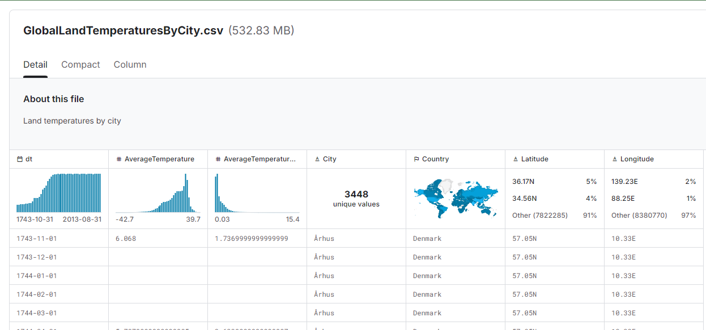
Dataset overview
Dataset Size:
600.6 MB
Approximately 8.5M rows
Dataset Timescale:
1743-2013
Dataset Attributes:
Date, Average Temperature, City, Country, and Coordinates

Slide 7
Dataset Files
Data | Size
GlobalLandTemperaturesByCity.csv | 532.83 MB
GlobalLandTemperaturesByCountry.csv | 22.68 MB
GlobalLandTemperaturesByMajorCity.csv | 14.11 MB
GlobalLandTemperaturesByState.csv | 30.77 MB
GlobalTemperatures.csv | 205.88 KB
Total | 600.6 MB

Slide 8
Process & Challenges
Designed a structured workflow to support tempo-spatial analysis of temperature data, from data ingestion → HDFS storage → Hive querying → CSV output → Visualization & Analyzation
Applied aggregational techniques to compute yearly and regional temperature averages
Organized data across multiple geographic levels for comparison
Integrated outputs into formats suitable for analyzations
Dealing with missing/sparse historical temperature records
Maintaining and Aligning data consistently across datasets with different geographic granularity for accurate trend analysis
Interpreting large-scale aggregated results without losing regional detail
Ensuring visualizations accurately reflect both temporal and spatial patterns

Slide 9

Our Work
Data Processing
Extracted Berkely Earth Temperature dataset from Kaggle
Cleaned and Structured ~600 MB of Data using Hadoop DFS
Queried Dataset using Hive to prepare data for analysis
Tempo-Spatial Analysis
Analyzed Temperature Records from the 1700s to 2010s
Calculated and Compared temperature changes/trends over time
Identified long-term global warming patterns and regional variation
Visualization and Output
Created Visualizations using Excel and Tableau to display temporal and geographic trends
Processed data and presented findings in an interpretable, data-driven format

Slide 10

Relevance to class
Demonstrated use of Hadoop Ecosystem
Applied distributed data storage and processing techniques
Handled multi-file, large-scale dataset using structured queries
Performed tempo-spatial analysis of chronological and geographic data
Integrated and implemented data engineering, querying, and visualization tools
Results suggest a value in expanding this work regarding the continued monitoring of regional climate trends

Slide 11
System & Hardware specifications
Type | Specification
Number of Nodes | 1
CPU | Intel Core i7-12700T
Threads | 20
CPU | 1.5 GHz
Memory | 16 GB
Storage | 953 GB

Slide 12




Process Workflow
Data Source: Server and Local
Hadoop & Hive
Data Visualization: Tableau & MS Excel
*Local Storage
*Original Storage
Notes:
Download climate datasets using wget from GitHub/Kaggle sources
Create HDFS directories for each dataset (global, country, city, state)
Upload CSV files into HDFS using hdfs dfs -put
Create external Hive tables linked to HDFS directories
Clean and transform data using Hive queries
Perform analysis queries and store outputs in HDFS directories
Export results to CSV files and transfer to local machine
Use Excel and Tableau for final visualization

Slide 13
Data Cleaning Process
Create cleaned tables using Hive queries
Remove null values
Extract year and month from date field for temporal analysis
Create separate cleaned datasets:
Land_temp_by_country_clean
Land_temp_by_city_clean
Global_temperatures_clean
Retain key attributes: temperature, uncertainty, location and coordinates
Improve query performants and ensure consistency across datasets

Slide 14
Analysis & Query Execution
Compute global yearly temperature averages using Hive aggregation
Calculate country-level average temperatures and rankings
Analyze temperature change between early and recent periods
Identify countries with the highest temperature increases
Perform city-level analysis to detect localized temperature changes
Generate century-based averages for long-term comparison

Slide 15
Output & Data Export
Store query results in HDFS directory
Output datasets include
Global_year.csv
Country_avg.csv
City_change.csv
Country_change.csv
Century_avg.csv
Combine output files and transfer to local machine for visualization

Slide 16
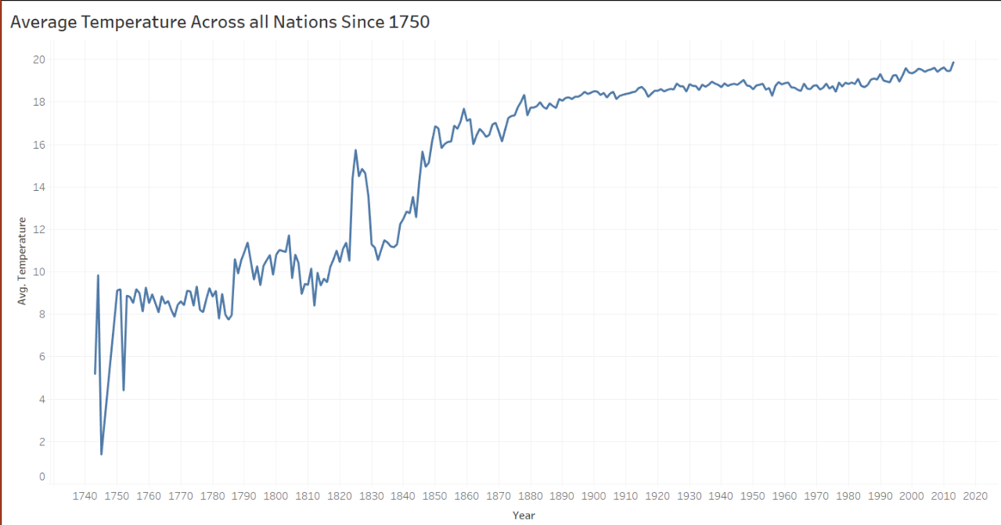
Key Finding 1 Global Temperature Trend
Notes:
Line chart shows average global temperature from ~1750–2015
Overall pattern indicates a steady upward trend over time
Early data (1700s–early 1800s) shows fluctuations due to limited measurements
Significant and consistent warming begins in the mid-19th century
Temperature continues to rise through the 20th and 21st centuries
Confirms long-term global warming trend using historical data

Slide 17
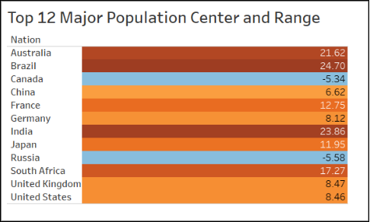
Key Finding 2 Temperature Average of 12 Nations in °C
Notes:
Bar chart compares average temperatures across 12 major countries
Significant variation observed between regions:
Canada: ~-5.34°C (coldest)
Brazil: ~24.70°C (warmest)
Warmer climates located near the equator show higher averages
Colder northern regions show significantly lower averages
Demonstrates strong geographic influence on temperature distribution

Slide 18
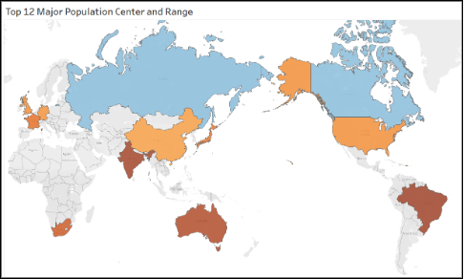
Key Finding 3 Map View Spatial Distribution
Notes:
Map visualization highlights geographic distribution of temperature averages
Warmer regions (e.g., Brazil, India, Australia) shown in higher temperature ranges
Colder regions (e.g., Canada, Russia) shown with lower temperature values
Clearly illustrates spatial variation across global regions
Supports tempo-spatial analysis by linking location with temperature patterns

Slide 19
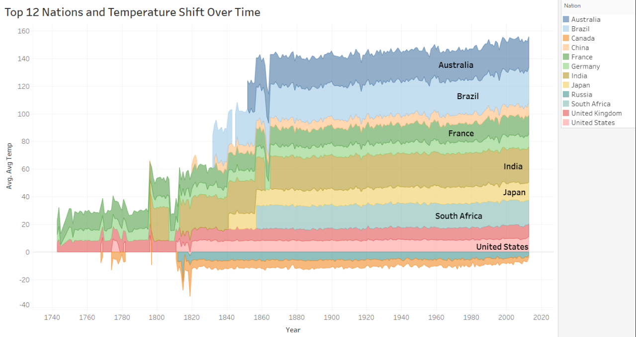
Key Finding 4 Temperature Change Trends Area Chart
Notes:
Map visualization highlights geographic distribution of temperature averages
Warmer regions (e.g., Brazil, India, Australia) shown in higher temperature ranges
Colder regions (e.g., Canada, Russia) shown with lower temperature values
Clearly illustrates spatial variation across global regions
Supports tempo-spatial analysis by linking location with temperature patterns

Slide 20
Key Finding 5 Temperature Change Rate by Nation
Nation | Change Avg. | Category
Australia | +0.78 °C | Moderate
Brazil | +1.04 °C | High
Canada | +1.94 °C | Very High
China | +1.38 °C | High
France | +1.26 °C | High
Germany | +1.30 °C | High
India | +0.90 °C | Moderate-High
Japan | +1.18 °C | High
Russia | +1.93 °C | Very High
South Africa | +0.98 °C | Moderate-High
U.K. | +1.05 °C | High
U.S. | +1.35 °C | High
Notes:
Table summarizes average temperature increase per country Highest increases observed in: Canada (+1.94°C)
Russia (+1.93°C)
Moderate increases in countries like India and Australia (<+1°C)
Majority of countries fall into “High” or “Very High” increase categories
Demonstrates that warming is widespread but varies by region

Slide 21
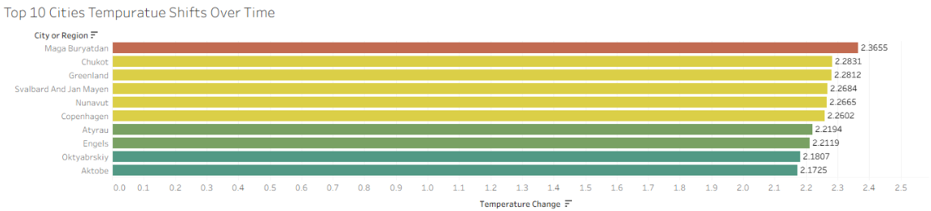
Key Finding 6 City-Level Temperature Patterns
Notes:
Bar chart highlights top cities with highest temperature changes
Some cities show increases exceeding +2°C
Indicates localized climate effects beyond national averages
Suggests influence of urbanization and regional environmental factors
Emphasizes importance of fine-grained (city-level) analysis

Slide 22
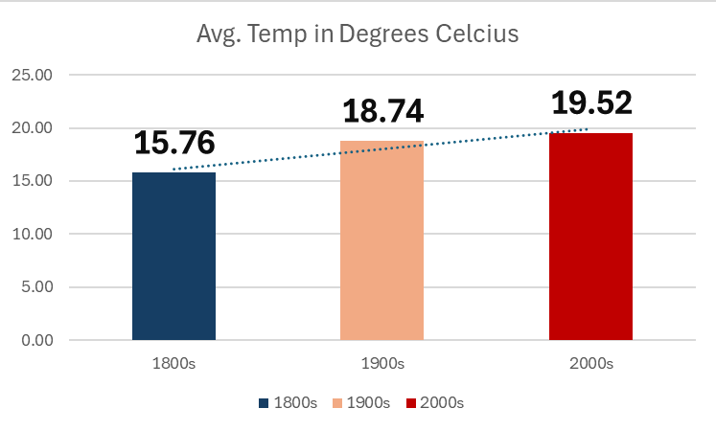
Key Finding 7 Climate change over 3 centuries in °C
Notes:
Bar chart compares average temperatures across three periods: 1800s: ~15.76°C
1900s: ~18.74°C
2000s: ~19.52°C
Shows a ~2°C increase over time Trend reflects impact of industrialization and human activity Demonstrates long-term accumulation of heat in Earth’s system Provides strong evidence of progressive global warming

Slide 23
Tempo-spatial Analysis & Visualization
Tableau
Excel 3D Maps & Charts
Highlighted tempo-spatial patterns
Line charts for global temperature trends
Geographic maps for regional comparison
Century comparison graphs
Aggregated data tables
Utilizing time-based trends and geographic variation

Slide 24
Recommendations
Consistent upward trends suggest a need for greater awareness of long-term climate patterns
Variations across regions indicate that environmental changes do not occur uniformly, e.g., Northern regions exhibit stronger warming trends
City-level analysis shows localized temperature spikes exceeding national averages
Century comparison confirms long-term warming (~2 °C increase)
Our work supports a need for further environmental and sustainability data-driven approaches to better understand global environmental challenges.

Slide 25
Conclusion
Our analysis of historical climate data reveals a clear and consistent increase in global temperatures over time
Warming trends become more pronounced beginning in the mid-19th century and continue into the present
Temperature changes vary across regions, city-level analysis shows that climate effects can differ significantly within countries
Our findings reinforce the importance of data-driven analysis in understanding long-term climate change patters
Implementation using Hadoop and Hive enabled efficient processing of large, multi-source datasets
Structured querying and data transformation allowed for accurate long-term tempo-spatial analysis
Visualization tools helped translate complex data into interpretable insights
Overall, our project demonstrates how big data technologies can be applies to real-world environmental datasets

Slide 26

Thank you

Slide 27
GitHub link
https://github.com/ItIsTariqAlam/CIS-4560-Term-Project-Tutorial-

Slide 28
References
[1] Berkeley Earth, Sissener, K., & Kaggle Team. (n.d.). Climate change: Earth surface temperature data. Kaggle. https://www.kaggle.com/datasets/berkeleyearth/climate-change-earth-surface-temperature-data
[2] Schnase, J. L., Lee, T. J., Mattmann, C. A., Lynnes, C. S., Cinquini, L., Ramirez, P. M., Hart, A. F., Williams, D. N., Waliser, D., Rinsland, P., Webster, W. P., Duffy, D. Q., McInerney, M. A., Tamkin, G. S., Potter, G. L., & Carrier, L. (2016). Big Data Challenges in Climate Science. IEEE geoscience and remote sensing magazine, Volume 4(Iss 3), 10–22. https://doi.org/10.1109/MGRS.2015.2514192
[3] Fan, J., Han, F., & Liu, H. (2014). Challenges of Big Data Analysis. National science review, 1(2), 293–314. https://doi.org/10.1093/nsr/nwt032
[4] Rohde, R. A., & Hausfather, Z. (2020). The Berkeley Earth land/ocean temperature record. Earth System Science Data, 12(4), 3469–3479. https://doi.org/10.5194/essd-12-3469-2020
[5] IPCC. (2021). Climate change 2021: The physical science basis. Summary for policymakers. Cambridge University Press. https://www.ipcc.ch/report/ar6/wg1/

Slide 29
References
[6] Mohajan, H. K. (2019, October). The first industrial revolution: Creation of a new global human era. Journal of Social Sciences and Humanities, 5(4), 377–387. https://www.researchgate.net/publication/336675822_The_First_Industrial_Revolution_Creation_of_a_New_Global_Human_Era
[7] Term Paper Earth’s Temperature Data Over the Years Using Hadoop : Tariq Alam, Ismahel Kennell Asturias, Julia Budano, Christian Garcia, and Nicholson Kon
[8] Lab Tutorial Using Hadoop and Hive to Analyze Climate Change Patterns: Tariq Alam Christian Garcia, and Nicholson Kon

